Slide 2
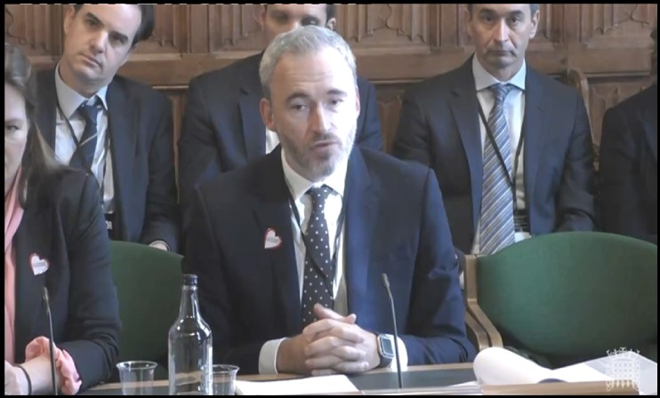
October 2022
Please view video on the Bristol Conversations website
Education Select Committee, 12th October 2022

Slide 3
October 2022
“Any assertion that exam grades
are wrong is not borne out by the evidence.
It comes from a misrepresentation of Ofqual's research.”
Dr Jo Saxton, Chief Regulator, Ofqual, in evidence to the Education Select Committee, 12th October 2022

Slide 4
October 2022
“Very few grades change when marking is reviewed…
this is a key piece of evidence that exam grades are right.”
Some data from 2019 exams in England
Total number of awards: 6,069,140
Total number of grade changes: 69,750
Grade changes as % of awards 1.15%
Total number of challenges: 343,905
Challenges as % of awards: 5.67%
Grade changes as % of challenges: 20.28%
Number of awards NOT challenged: 5,725,235
https://www.gov.uk/government/statistics/reviews-of-marking-and-moderation-for-gcse-as-and-a-level-summer-2019-exam-series

Slide 5
September 2020
Exam grades are
“reliable to one grade
either way”.
Dame Glenys Stacey, Acting Chief Regulator, Ofqual,
evidence to the Education Select Committee, 2nd September 2020

Slide 6
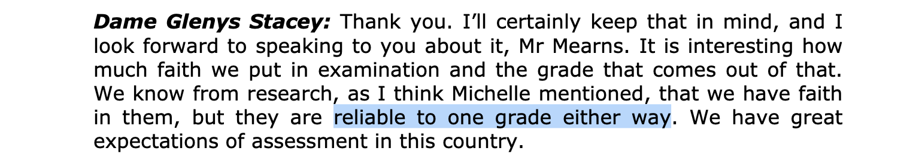
September 2020
Source: Transcript of Education Select Committee, 2nd September 2020
https://committees.parliament.uk/oralevidence/790/pdf/, Q1059

Slide 7
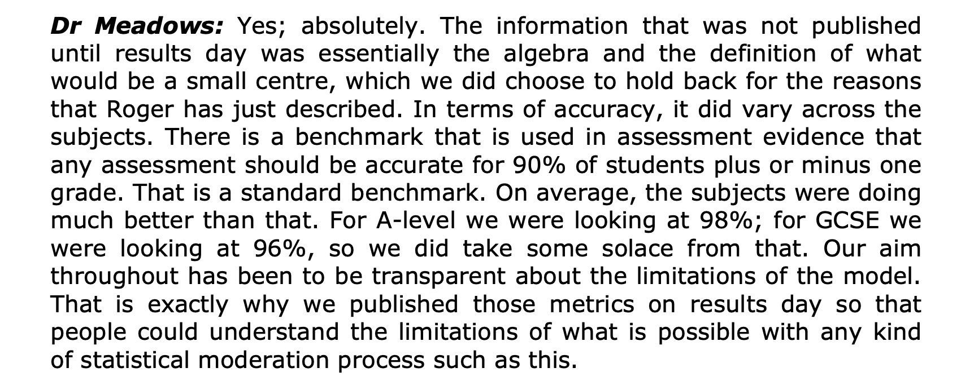
September 2020
Source: Transcript of Education Select Committee, 2nd September 2020
https://committees.parliament.uk/oralevidence/790/pdf/, Q997

Slide 9
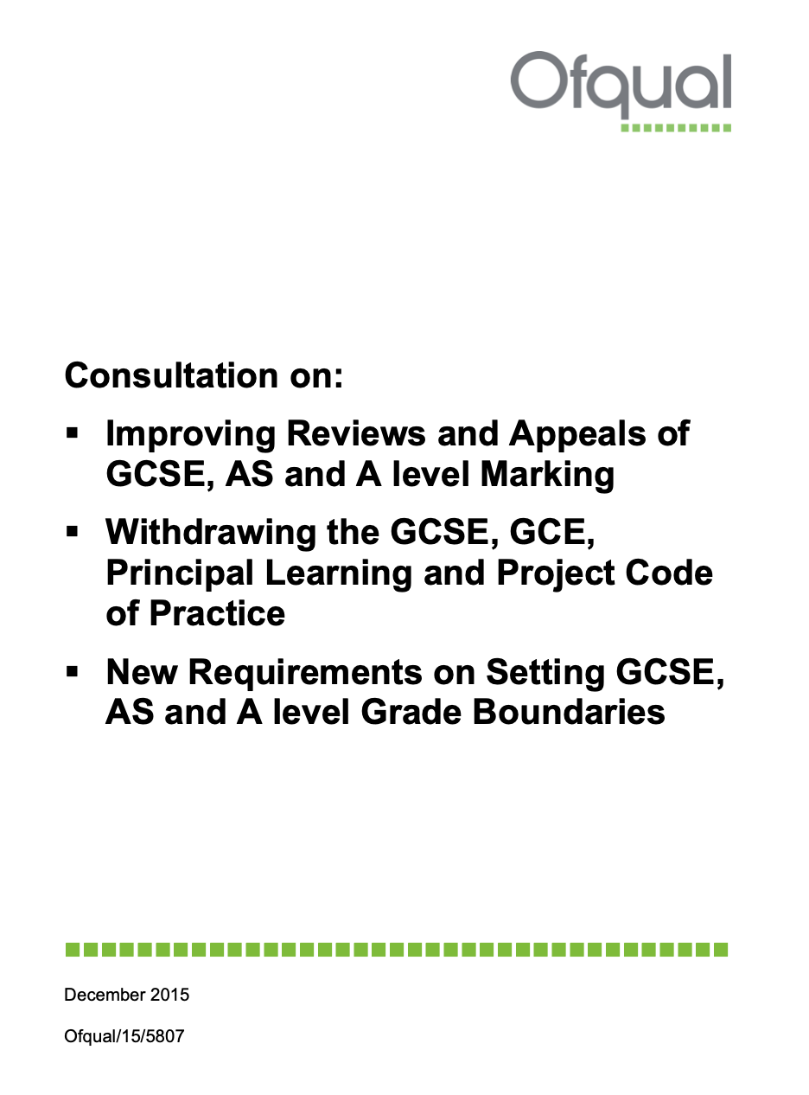
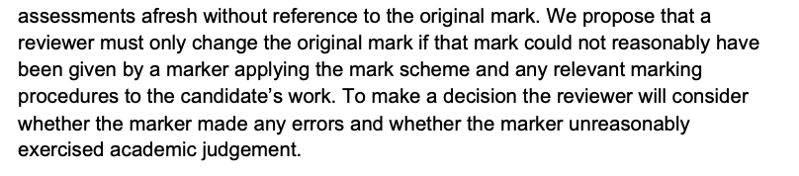
December 2015
Source: https://assets.publishing.service.gov.uk/government/uploads/system/uploads/attachment_data/file/484658/Consultation_on_marking_reviews__appeals__grade_boundaries_and_Code_of_Practice.pdf, page 25

Slide 10
June 2016
There is often no single, correct mark for a question. In long, extended or essay-type questions it is possible for two examiners to give different but appropriate marks to the same answer. There is nothing wrong or unusual about that. Original marks that are appropriate for an individual answer will stand – they should not be changed.
Source: The Ofqual blog, 3rd June 2016
https://ofqual.blog.gov.uk/2016/06/03/gcse-as-and-a-level-marking-reviews-and-appeals-10-things-you-need-to-know/

Slide 11
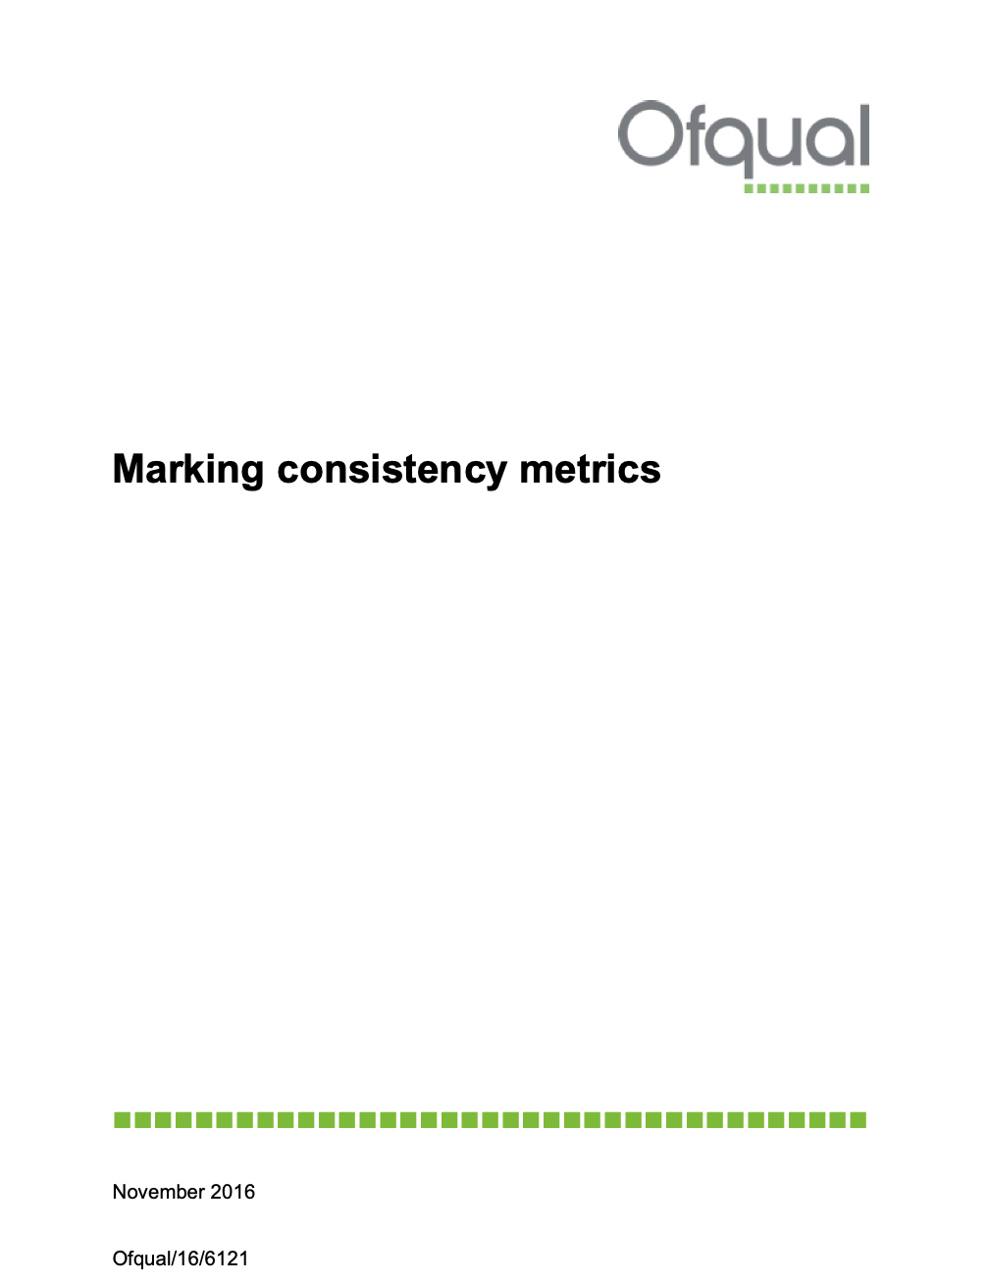
November 2016

Slide 12
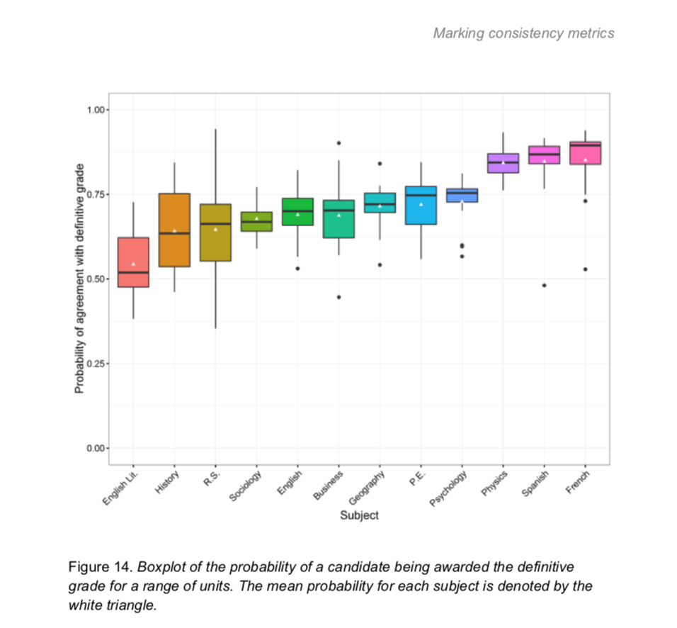
Probability of definitive (‘true’) grade
November 2016
85%
69%
54%
Source: Ofqual Marking Consistency Metrics, November 2016

Slide 13

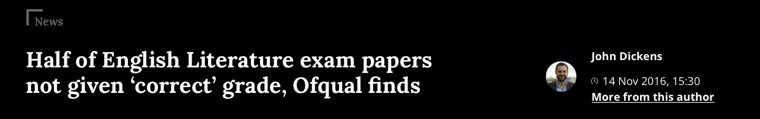
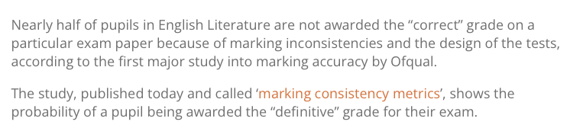
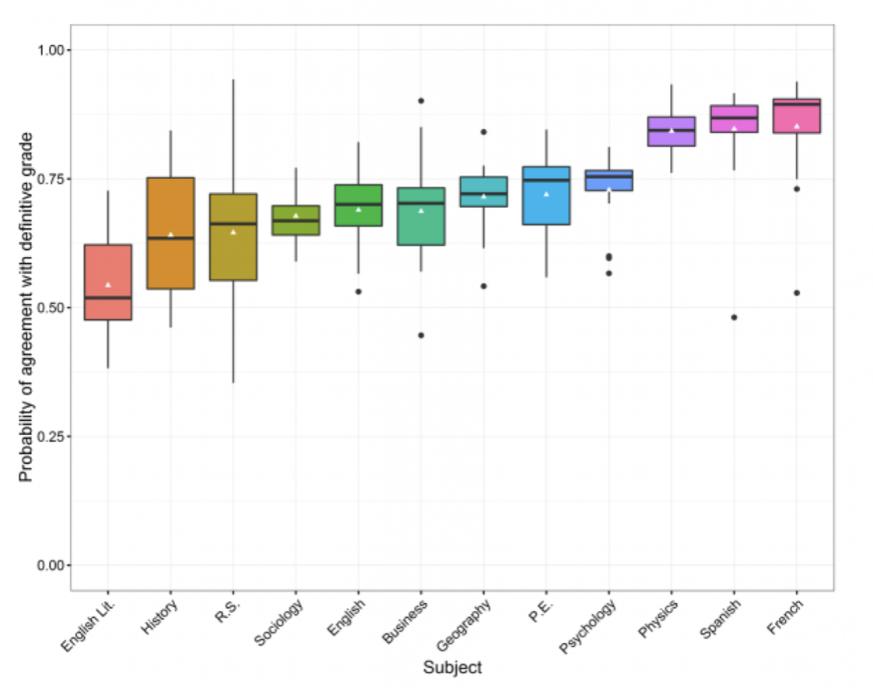
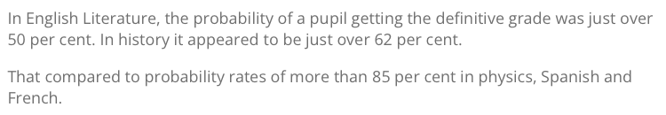
November 2016

Slide 14

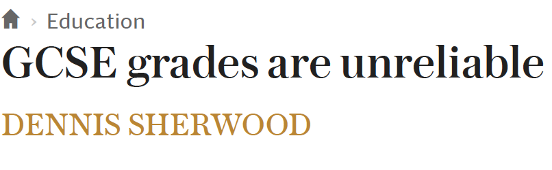
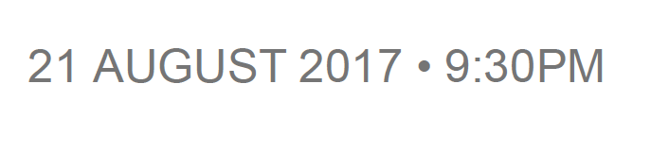
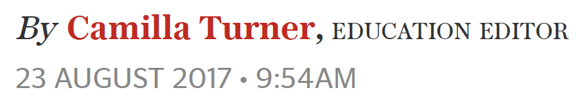
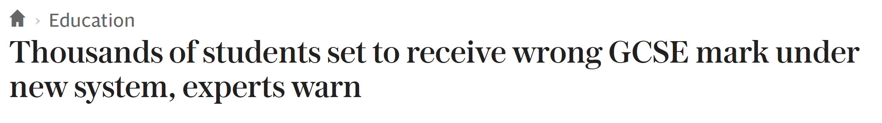
August 2017

Slide 15
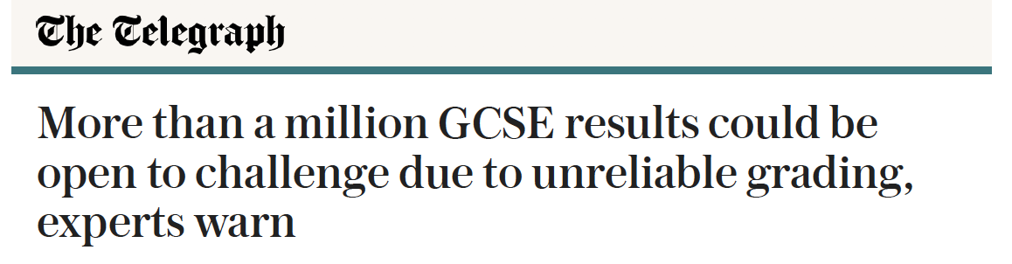
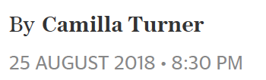


August 2018

Slide 16
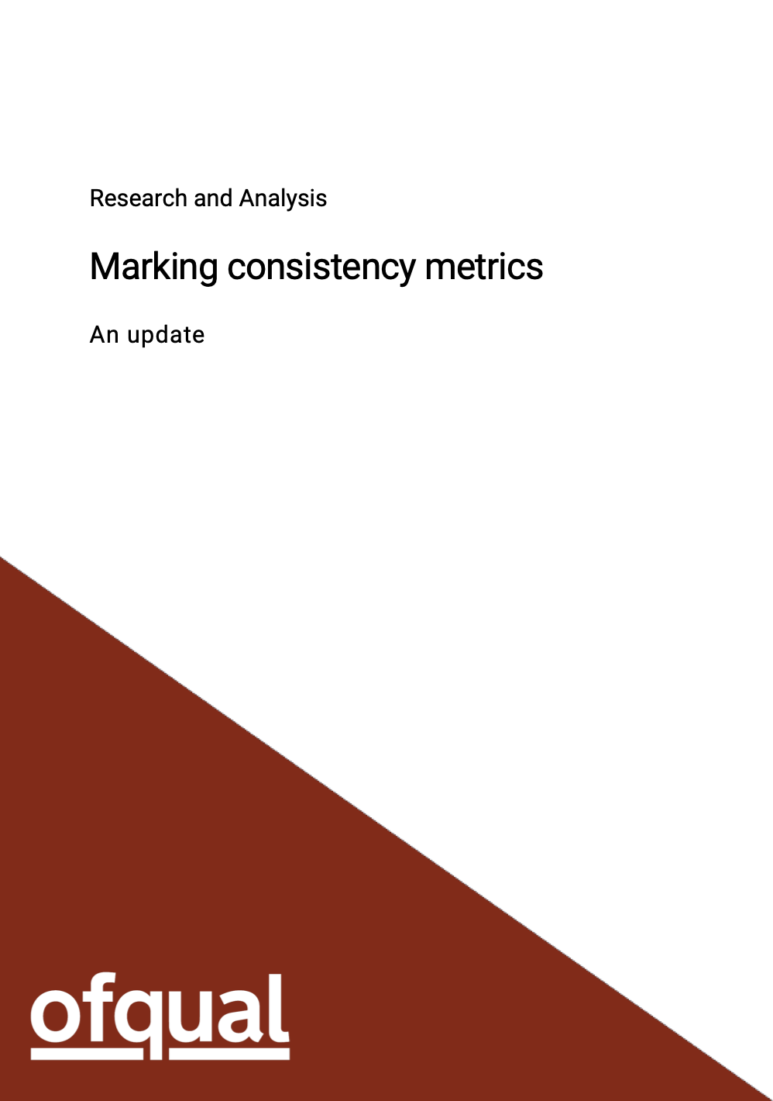
November 2018

Slide 17
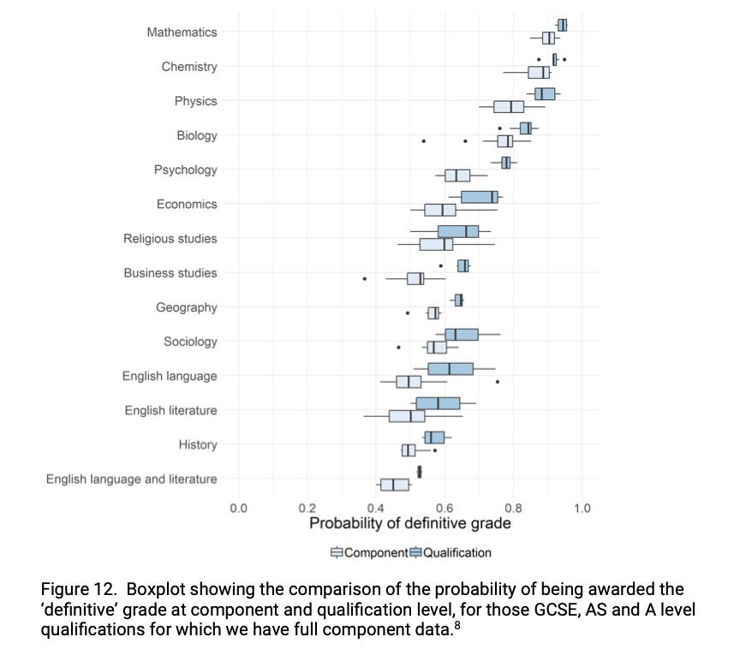
November 2018
96%
92%
88%
85%
78%
74%
66%
66%
65%
63%
61%
58%
56%
52%
Marking Consistency Metrics - An Update

Slide 18
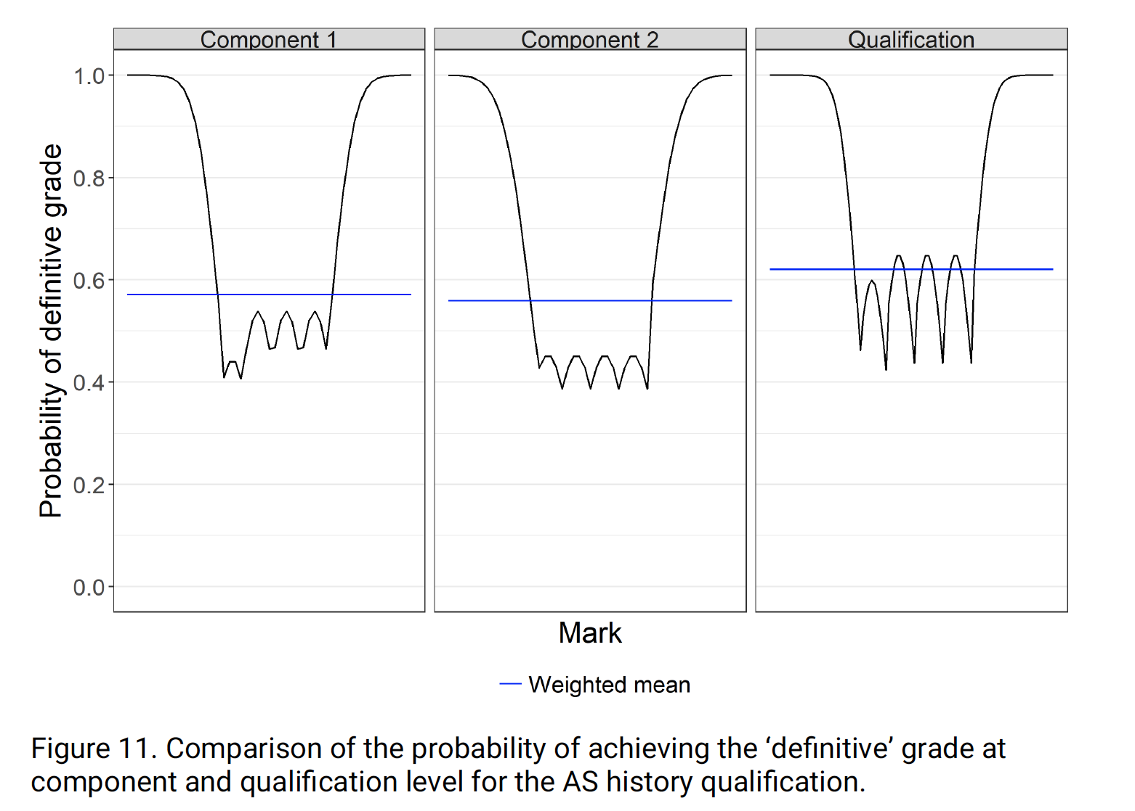
November 2018
0.47
U
E
D
C
B
A
62
Marking Consistency Metrics - An Update
November 2016

Slide 19

2022 GCSE English
Average, 61%
U
1
2
3
4
5
6
7
8
9
Source: my simulation

Slide 20

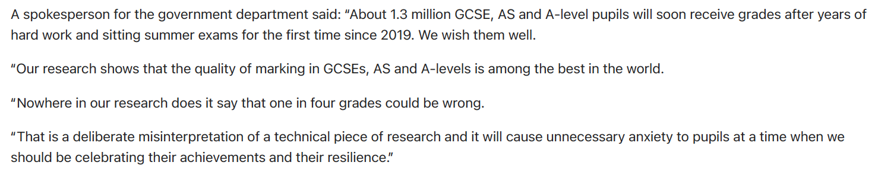
August 2022

Slide 21
How the 2020
algorithm was tested
August 2018
Comparable range
of predicted
accuracies
Source: Ofqual Interim Report, 13th August 2020

Slide 23
NO!!!
The problem is NOT “sloppy marking”!!!
It’s “fuzziness”

Slide 24
'Right/wrong’ marks
X
X
X
X
59
64
70
76
D
C
B
A
A*

Slide 25
Somewhat fuzzy marks
X
X
X
X
59
64
70
76
D
C
B
A
A*

Slide 26
Quite fuzzy marks
X
X
X
X
59
64
70
76
D
C
B
A
A*

Slide 27
Current policy
m = 69
X
m* = 72
X
59
64
70
76
D
C
B
A
A*
Original grade = B
Grade after re-mark = A

Slide 28
The reality
m – f = 65
m = 69
m + f = 73
X
f = 4
59
64
70
76
D
C
B
A
A*

Slide 29
Grading according to m + f
m – f = 65
m = 69
m + f = 73
X
f = 4
m* = 72
X
59
64
70
76
D
C
B
A
A*
Original grade = A
Grade after re-mark = A

Slide 30
Grading according to m – f
m – f = 65
m = 69
m + f = 73
X
f = 4
m* = 72
X
59
64
70
76
D
C
B
A
A*
Original grade = B
Grade after re-mark = B

Slide 31
No grades, award m ± f
m – f = 65
m = 69
m + f = 73
X
f = 4
m* = 72
X
59
64
70
76
Original grade = 69 ± 4
Grade after re-mark = 69 ± 4

Slide 32
June 2016
There is often no single, correct mark for a question. In long, extended or essay-type questions it is possible for two examiners to give different but appropriate marks to the same answer. There is nothing wrong or unusual about that. Original marks that are appropriate for an individual answer will stand – they should not be changed.
Source: The Ofqual blog, 3rd June 2016
https://ofqual.blog.gov.uk/2016/06/03/gcse-as-and-a-level-marking-reviews-and-appeals-10-things-you-need-to-know/

Slide 33
October 2022
“Any assertion that exam grades are wrong is not borne out by the evidence.
It comes from a misrepresentation of Ofqual's research.”
Dr Jo Saxton, Chief Regulator, Ofqual, in evidence to the Education Select Committee, 12th October 2022

Slide 34
Today’s BIG QUESTION
Are exam grades
“reliable to one grade either way”
reliable enough?

Slide 35
What next?

Slide 37
Number of examiners
giving mark
Mark

Slide 38
Number of examiners
giving mark
Mark

Slide 39
The BIG PROBLEM
A script is given a mark, say, 64.
What is the mark that would be given to that script by a senior examiner?

Slide 40
Given mark m = 64
Mark
57
58
59
60
61
62
63
64
65
66
67
68
69
70
71

Slide 41
Given mark m = 64
Mark
57
58
59
60
61
62
63
64
65
66
67
68
69
70
71

Slide 42
Given mark m = 64
Mark
57
58
59
60
61
62
63
64
65
66
67
68
69
70
71
Range of possible medians, 6 marks
Range of possible re-marks, 12 marks

Slide 44
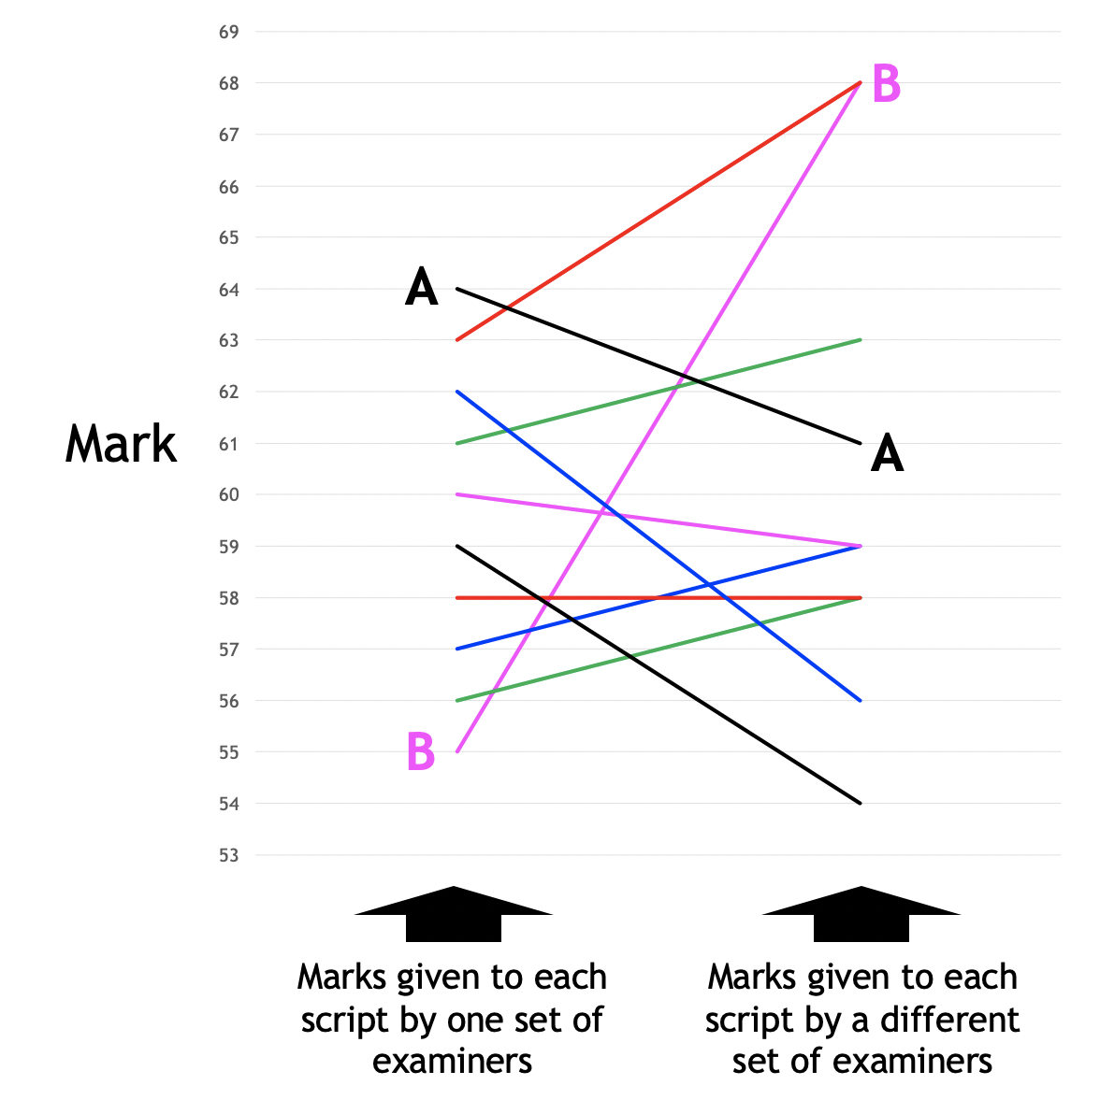
Unreliable rank orders
2019 A level Geography
Source: My own simulation

Slide 45
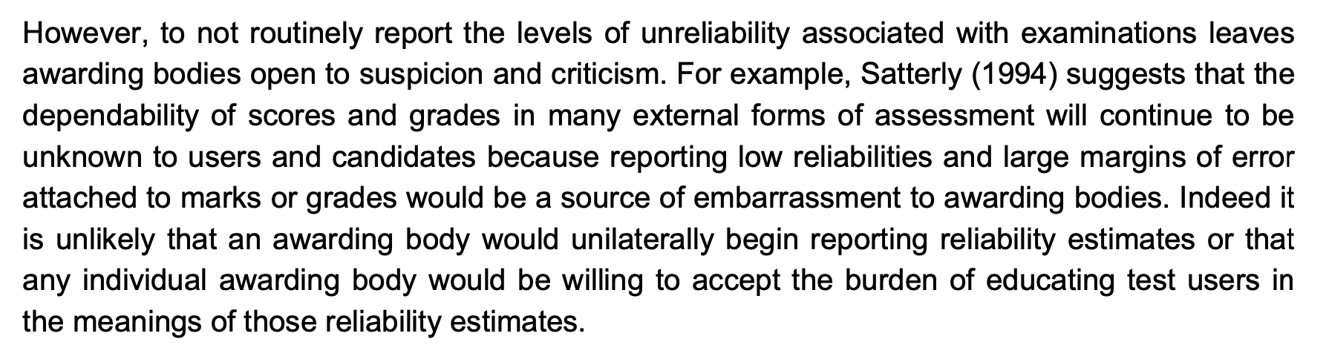
A review of the literature on marking reliability
Michelle Meadows and Lucy Billington, AQA, 2005
https://filestore.aqa.org.uk/content/research/CERP_RP_MM_01052005.pdf

Slide 48
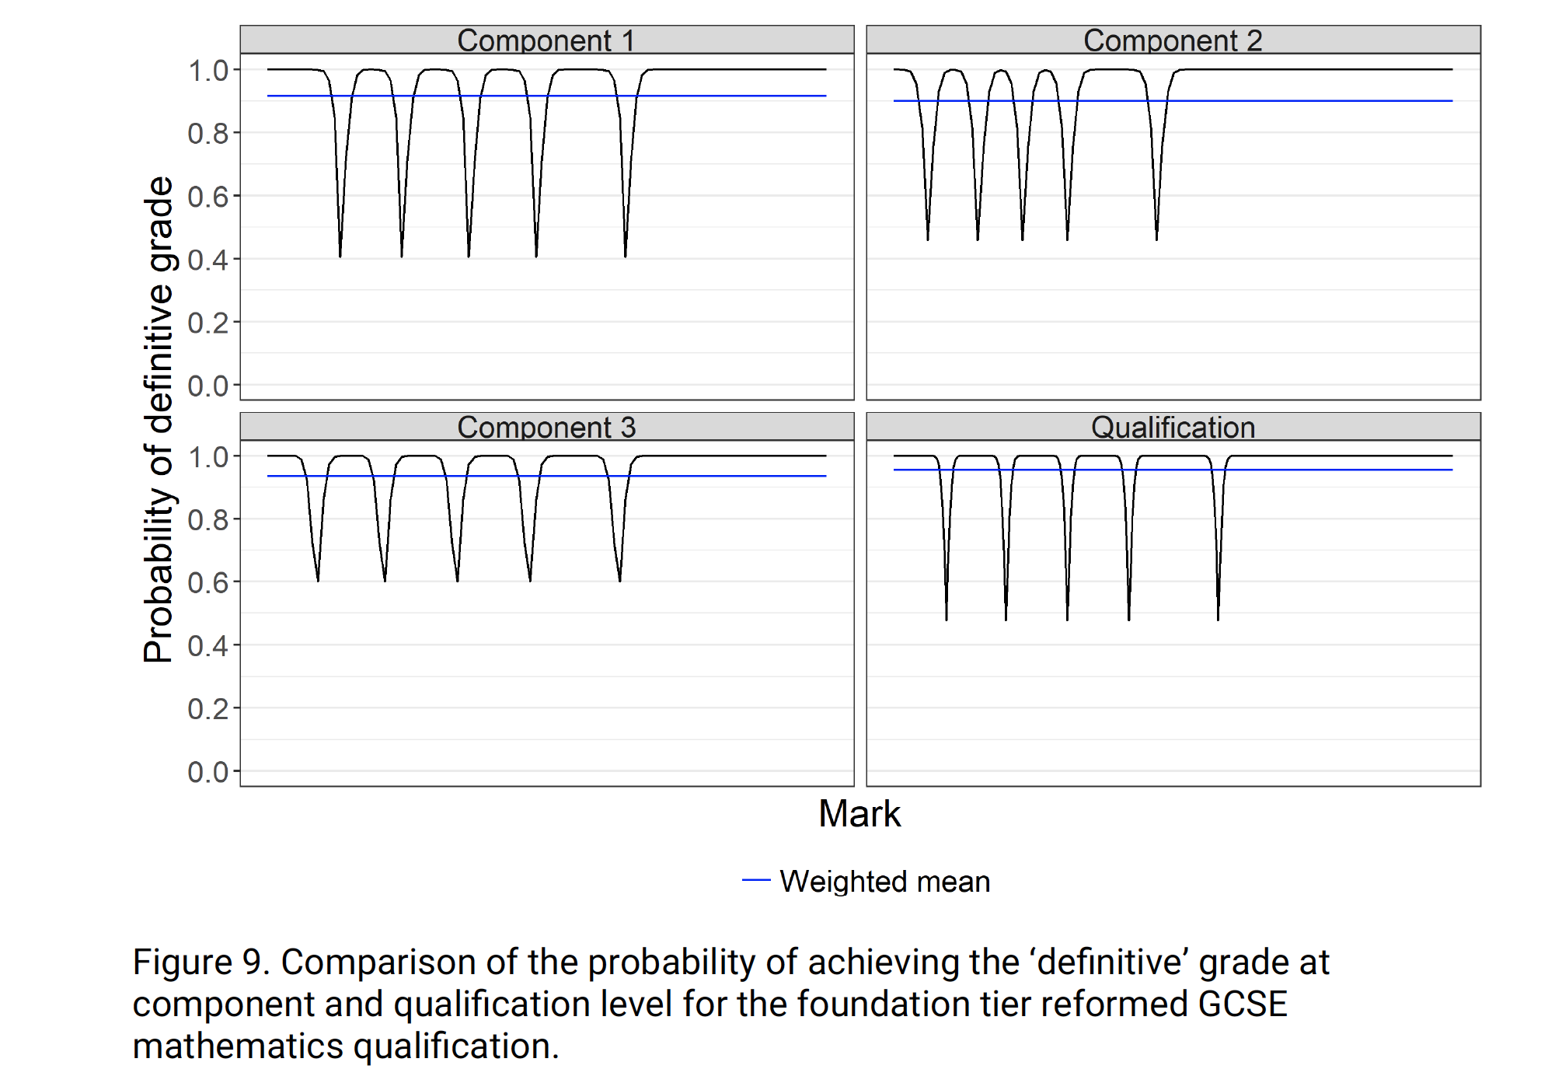
Marking Consistency Metrics - An Update

Slide 49
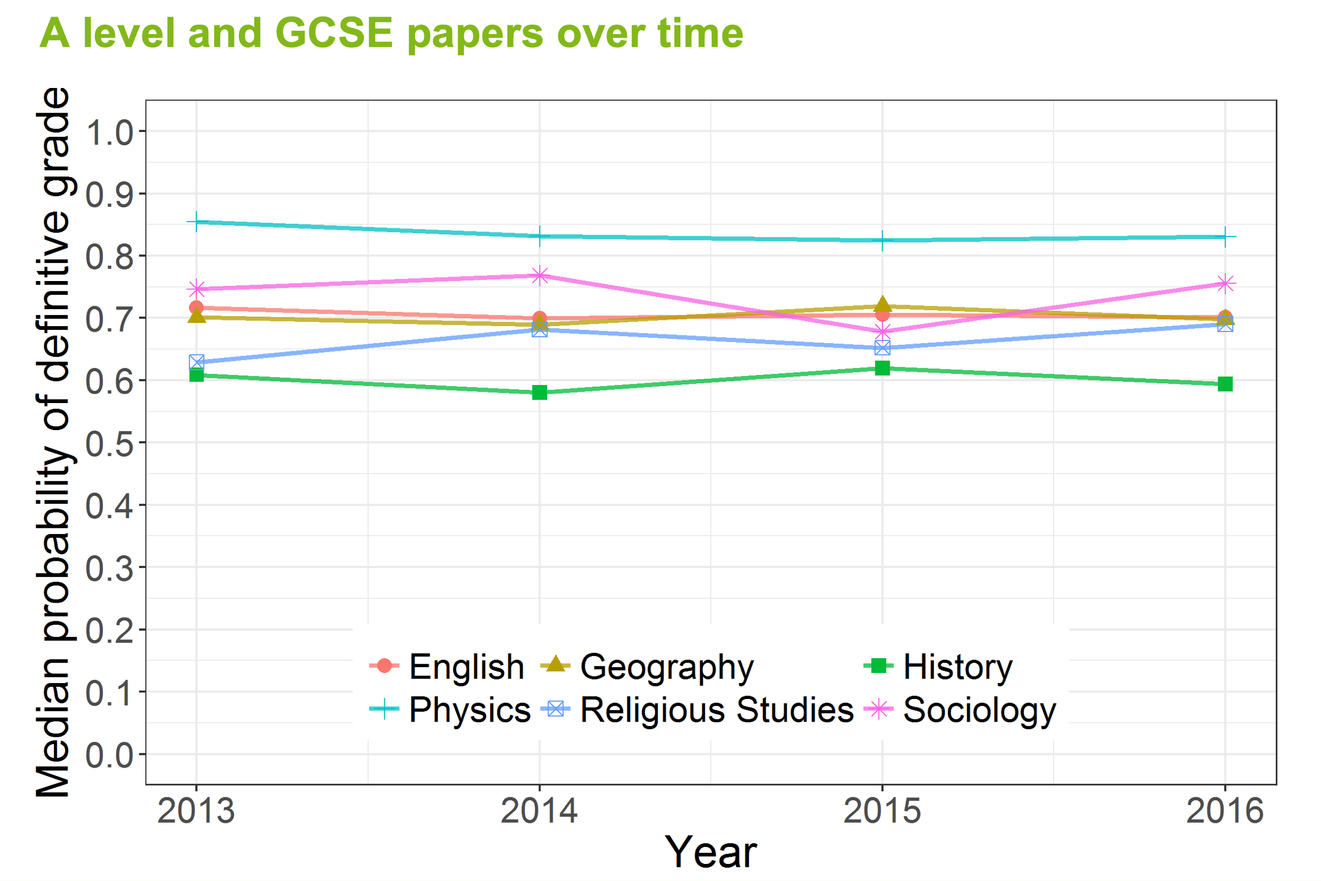
Source: Ofqual Summer Symposium 2017

Slide 50
2022 GCSE English, graded as m
Average, 61%
U
1
2
3
4
5
6
7
8
9
Source: my simulation

Slide 51
2022 GCSE English, graded as m + 10
Average, 61%
Average, 61%
U
1
2
3
4
5
6
7
8
9
Source: my simulation

Slide 52
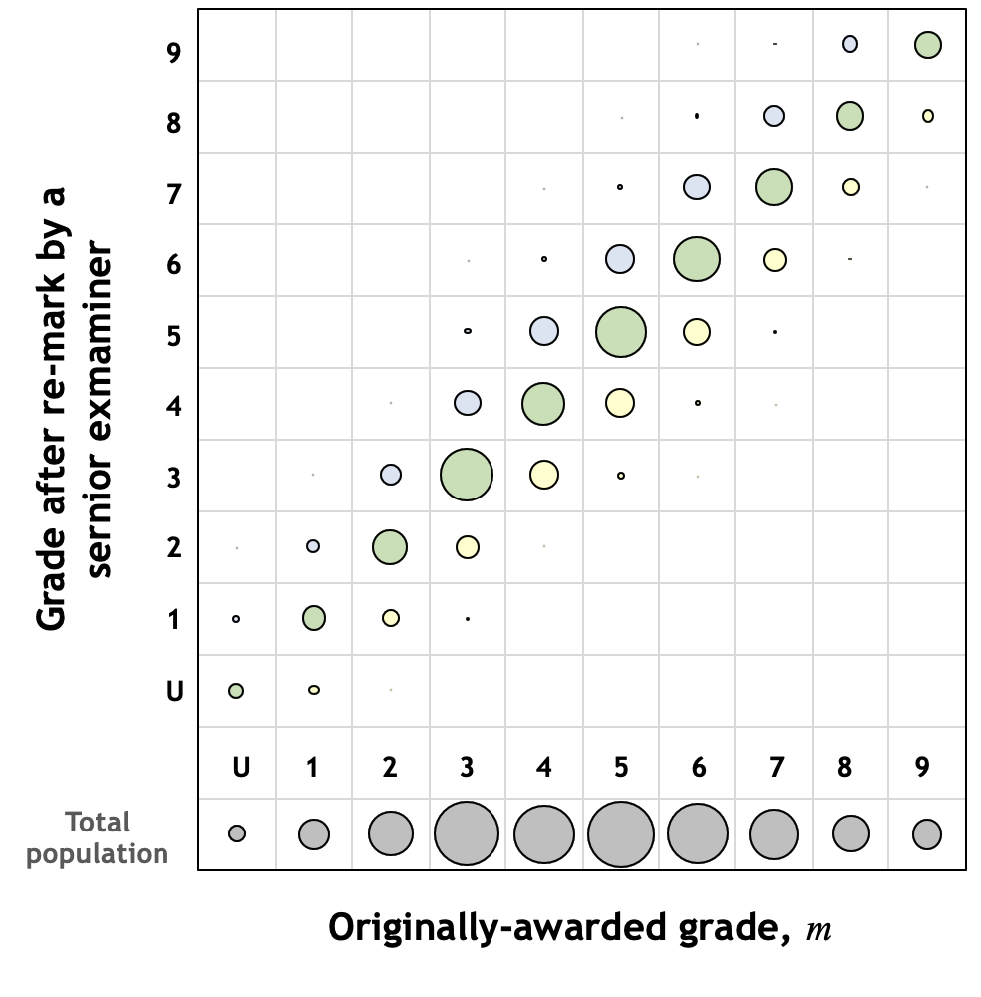
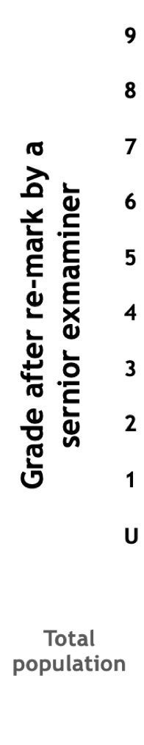
2022 GCSE English, graded as m
Source: my simulation

Slide 53
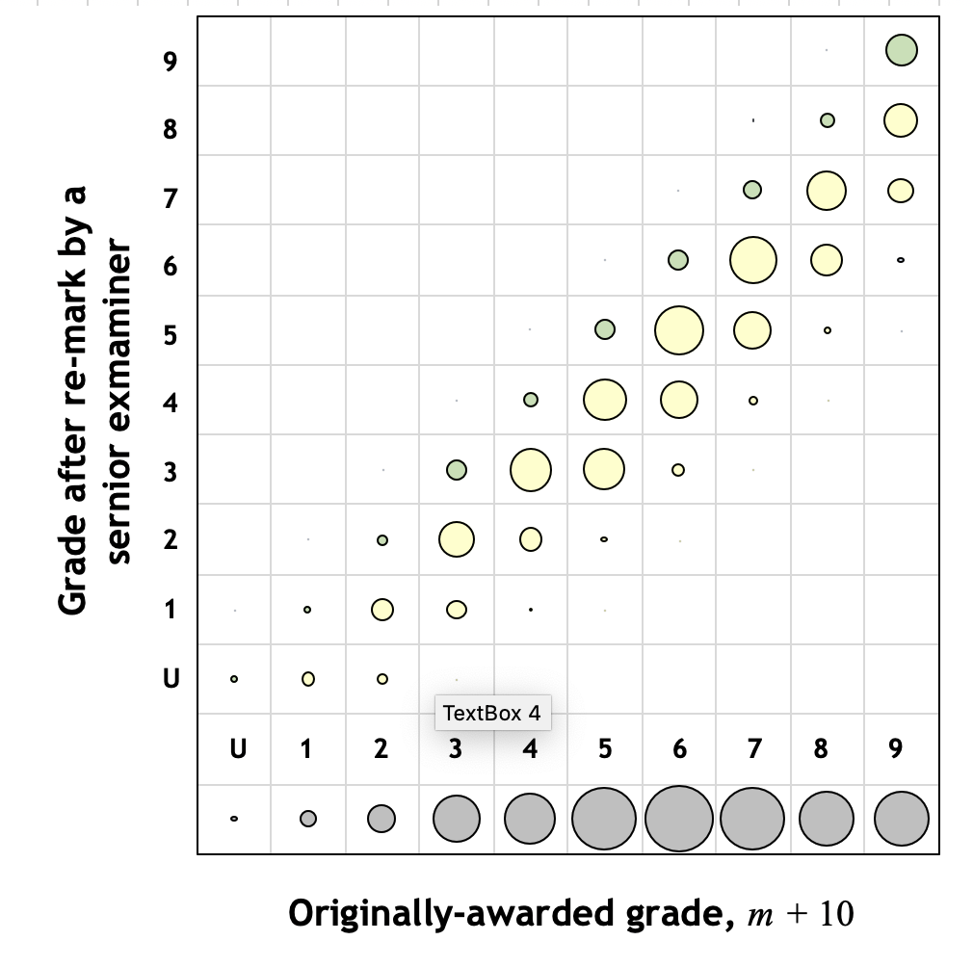
2022 GCSE English, graded as m + 10
Source: my simulation

Slide 54
September 1888
That examination is a very rough, yet not wholly inefficient,
test of merit is generally admitted.
F.Y. Edgeworth, The Statistics of Examinations, Journal of the Royal Statistical Society, Vol. 51, No. 3, September 1888, pp. 599-63

Slide 55
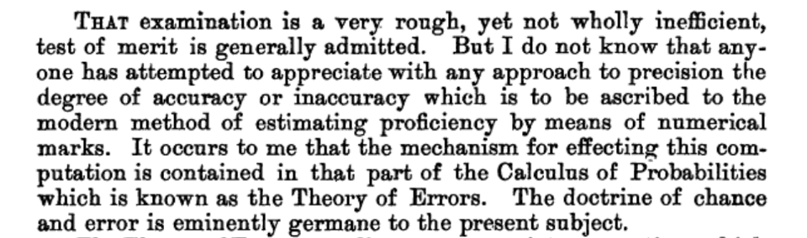

Slide 56
September 2014
We know that qualification grade changes represent just 0.6 per cent of all GCSE, AS and A level certifications.
On this evidence, we might conclude that a little over 1 in 200 exam papers contained a marking error or inconsistency, but that assumes that all unchallenged grades are as correct as those challenged.
We are requiring exam boards to agree the best metrics for measuring and reporting on marking quality; we will work towards the publication of an agreed overall reliability measure for their examinations.
And we are about to consult on proposals to improve the appeal system so as to make it more fair, more effective and more transparent. We will welcome your views.
Glenys Stacey, Ofqual blog, 29th September 2014

